Slide 1
Project 1 : Gold Price Forecasting
TEAM MEMBERS :
1.HIMANSHU PATIL
2.INDRANI
3. SMITA DHURI
4. Y BHEEMESH KUMAR
5.NIDHI
6.SAURABH MESTRY
7.SIRI

Slide 2
Context
Business Problem Understanding
Business Objective
Visualization
Model Building
Model Deployment

Slide 3
Business Problem Understanding
This is a gold import and export company
Another Threat is speculators that accumulate or let go of gold in the market can create temporary imbalances that lead to rapid price changes.

Slide 4
Difficulties
EDA : We were not assured how to handle time series data
Model building : We were facing issues with neural networks(LSTM)
Model deployment : Not able to load the file with pickle

Slide 5
Business Objective
The objective is to import gold during it’s low price and export gold during High time
Another objective is to store enough gold To fulfil demand during it’s season

Slide 6
EDA Visualization

Slide 7
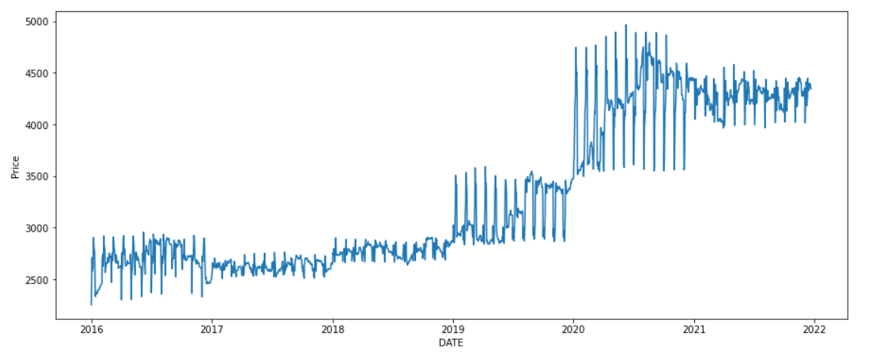
Checking Trend in data
We can see there is a gradual increase in the year 2019 and 2020

Slide 8
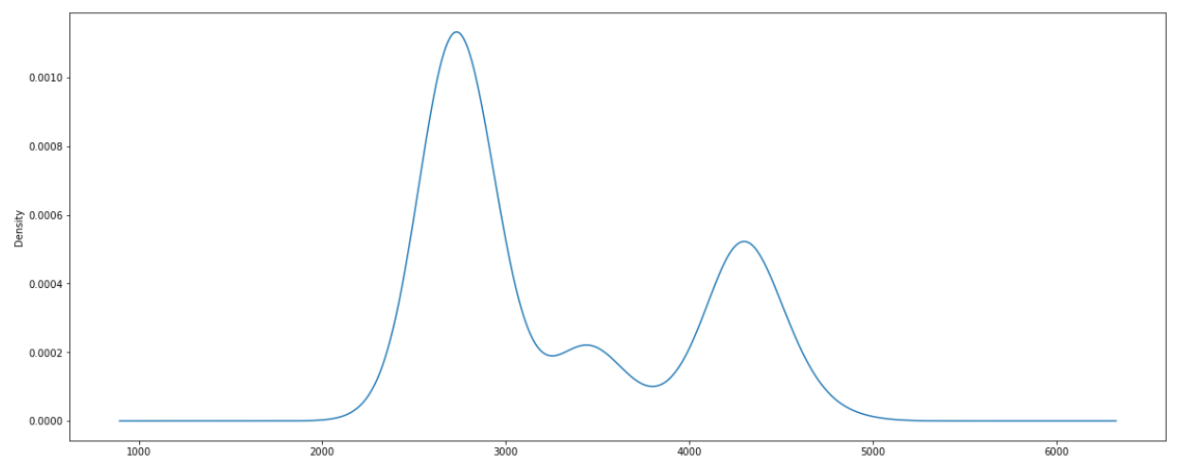
Density Plot
We can see that the Prices ranges between
2000 to 3000 and a little bit in
4000 to 5000

Slide 9
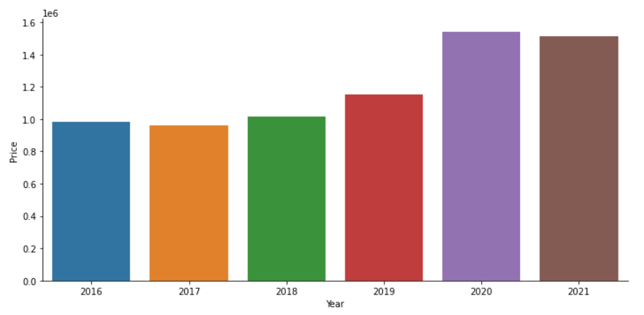
Total sales in each year
We can see that the prices are highly increased in 2020 and a
bit low in 2017 than it’s previous year

Slide 10
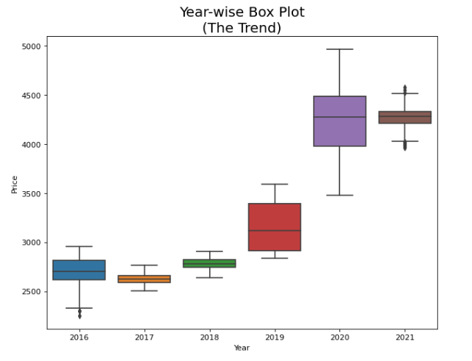
Boxplot for year wise trend
We can see that the mean of prices for unique year was same till 2019 but increased in 2020
There are Outliers in 2016 and 2021

Slide 11
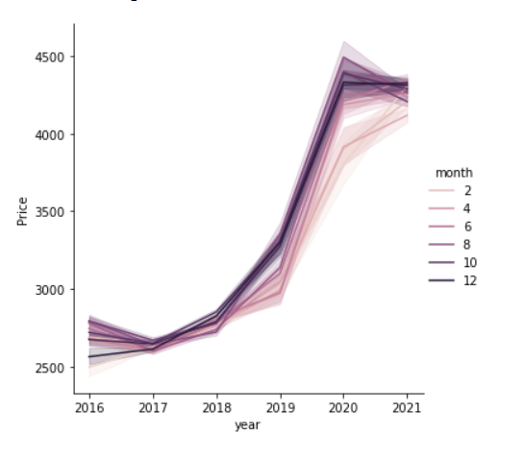
Year wise trend on monthly basis
We can see that there is a gradual increase for every month irrespective of the years

Slide 12
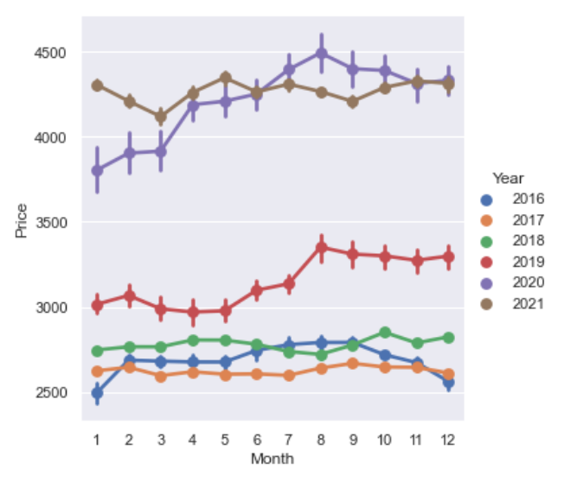
Month wise Trend on Yearly basis

Slide 13
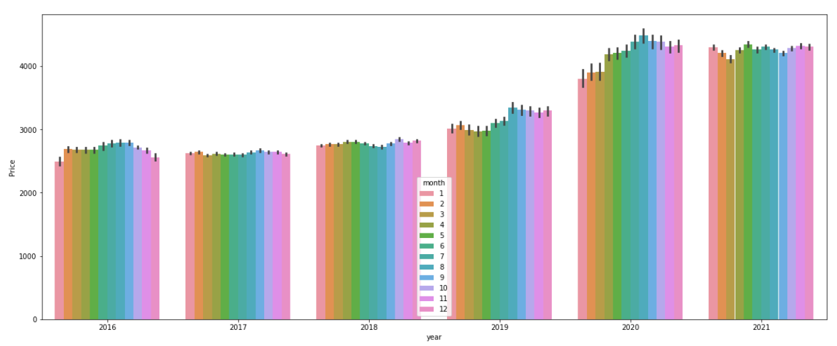
Bar plot
This is a bar plot for each year on monthly basis.

Slide 14
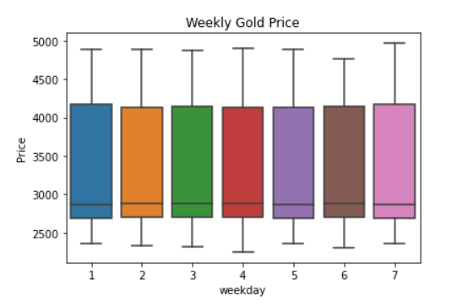
Weekly Trend
There is no weekly trend on this dataset.

Slide 15
Stationary Test
In the beginning it was not a stationary data set
Following were the output
ADF statistic value were : -0.3099
P values was : 0.9240899
Weak evidence against null hypothesis , Time series has a unit root , It is a non stationary data set
By using the difference technique where we take a difference with the next row we overcome the problem
Following were the output
ADF statistic value were : -21.6645
P value was : 0.00
Strong evidence against null hypothesis . Data has no unit root and is stationary

Slide 16
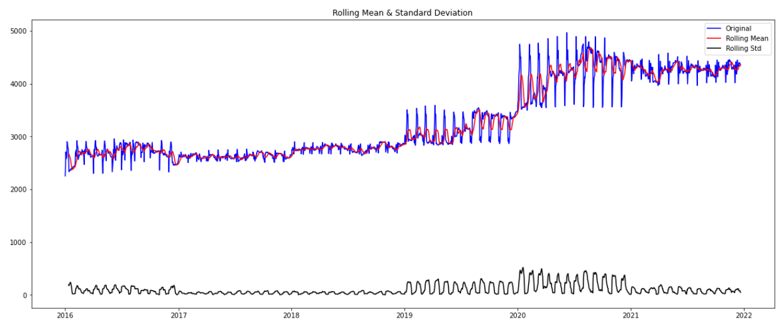
Non Stationary Visualization

Slide 17
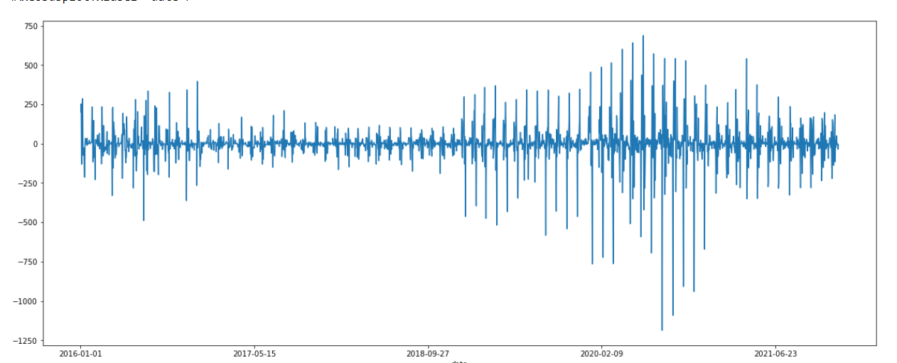
Stationary Visualization

Slide 18
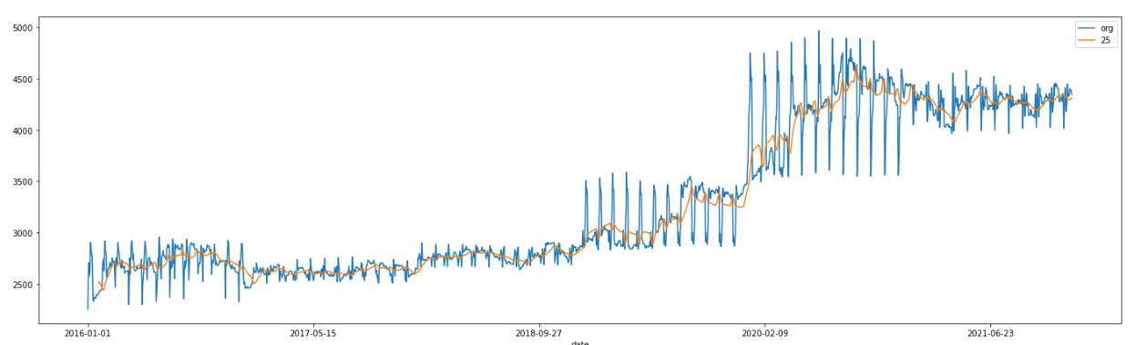
Rolling Mean

Slide 19
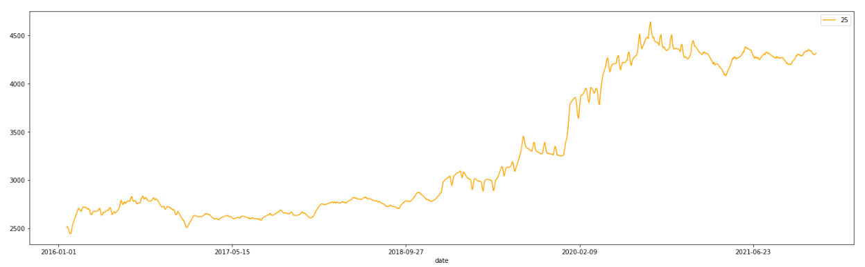
Simplified Rolling mean visualization

Slide 20
MODEL BUILDING

Slide 21
Model Building
ARIMA
SARIMA
Prophet
HOLT WINTERS
XGBOOST
LSTM

Slide 22
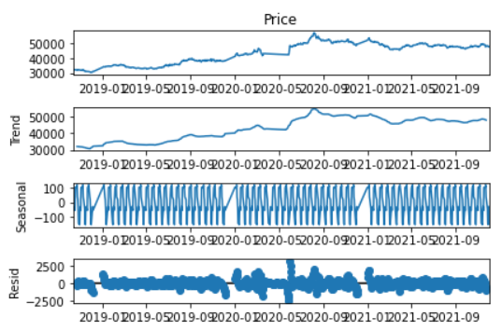
Seasonal Naïve Model
This is the seasonal decompose for naïve model
Here we have tried to predict the next data using the previous data
It has a RMSE value of 578

Slide 23
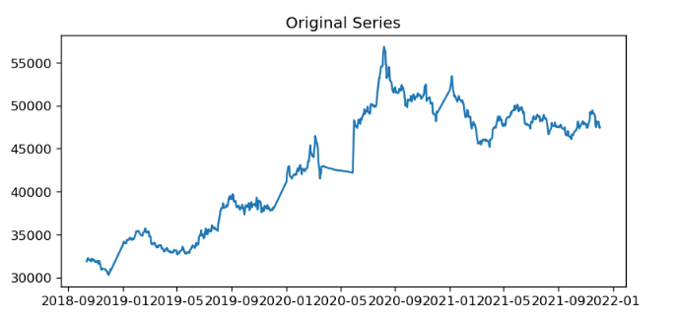
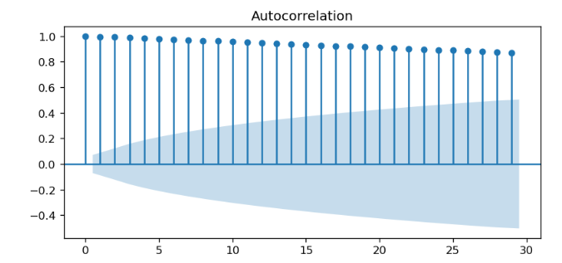
Original Series

Slide 24
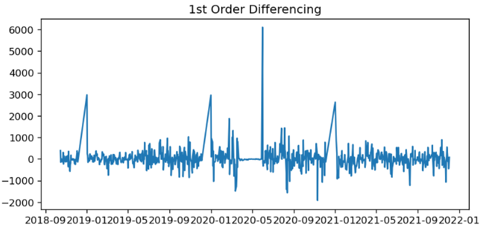
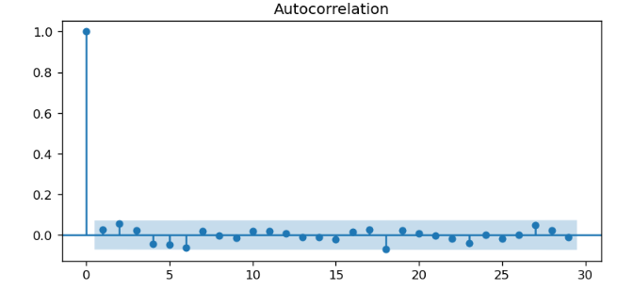
First order differencing

Slide 25
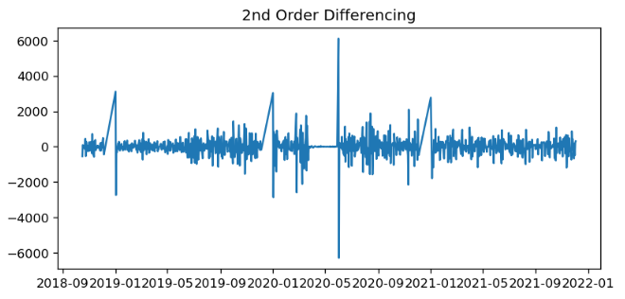
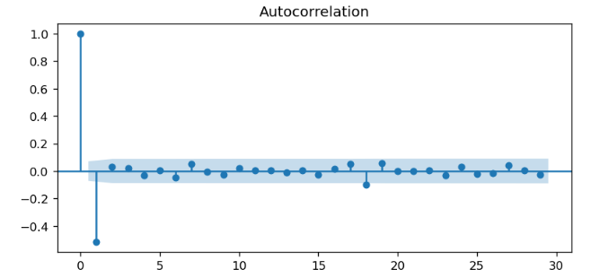
Second Order Differencing

Slide 26
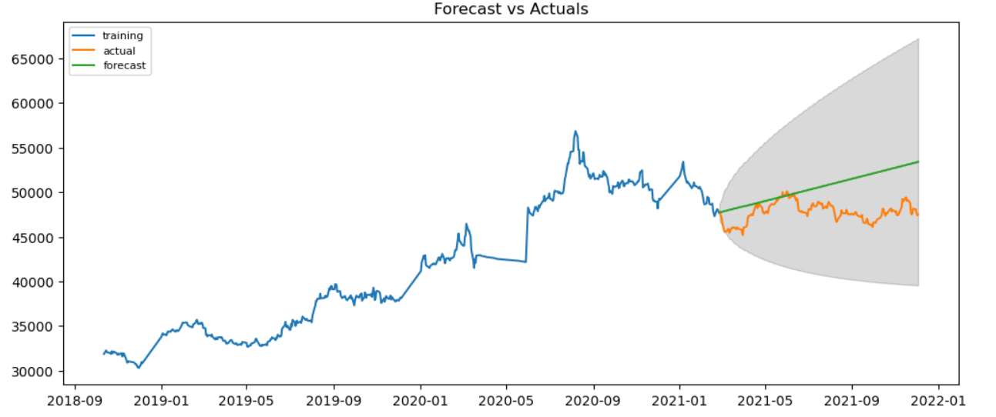
ARIMA
ARIMA with the order (0,1,0)

Slide 27
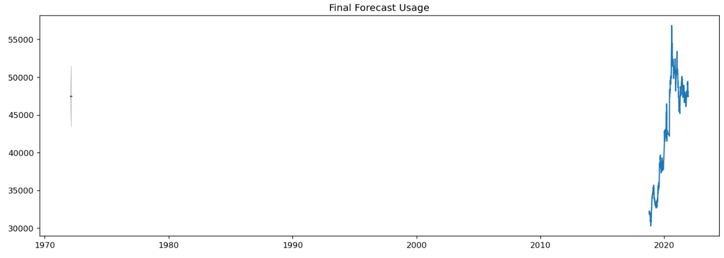
Final Forecast Usage
This is the forecast predicted by the model using ARIMA

Slide 28
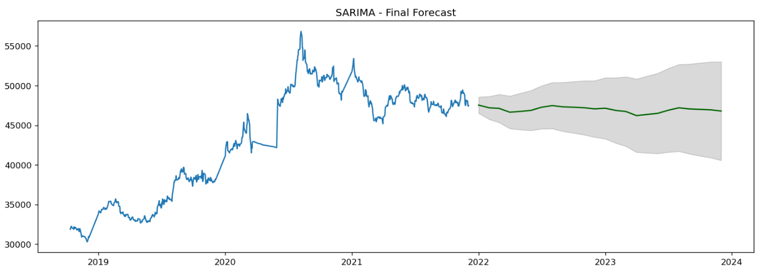
SARIMA
pmd.auto arima for order (1,0,1)(0,1,0)

Slide 29
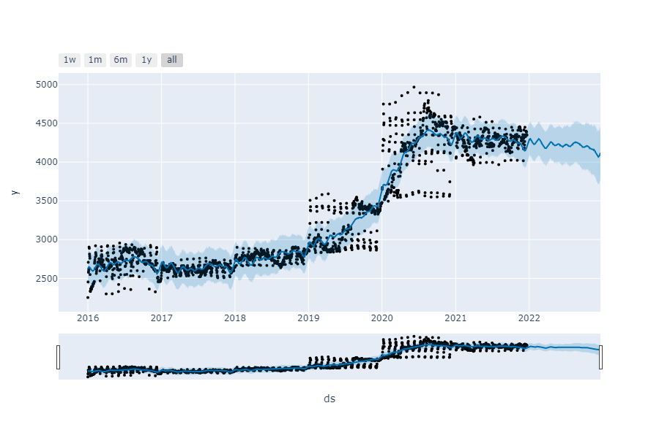
PROPHET
Here in this visualisation we can see the dots are the upper and lower bound of the precise in the data, whereas the blue line is the prediction and light blue is the confidence interval with 95%

Slide 30
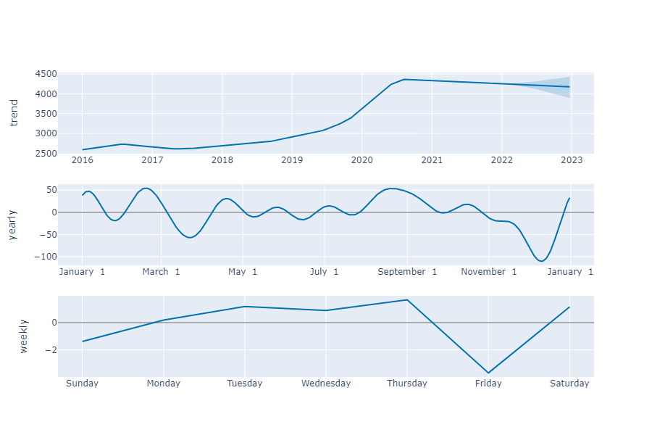
PROPHET
This shows the trends available in the data .According to Prophet

Slide 31
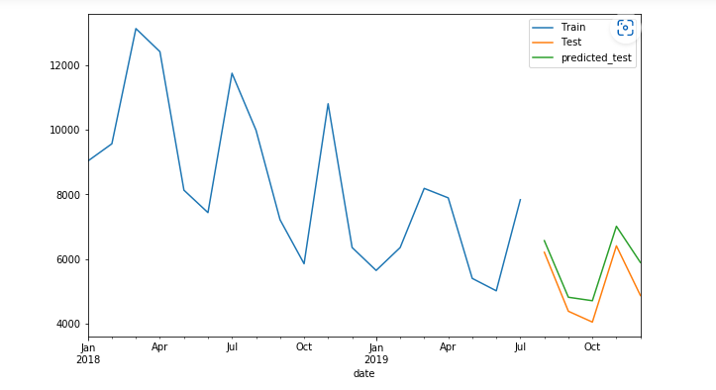
HOLT WINTERS
In this model we can see that the data is classified into train and test data and the prediction is shown for the test data.
The blue line is train data and the
Orange line represents test data and the green line represents prediction of the test data.

Slide 32
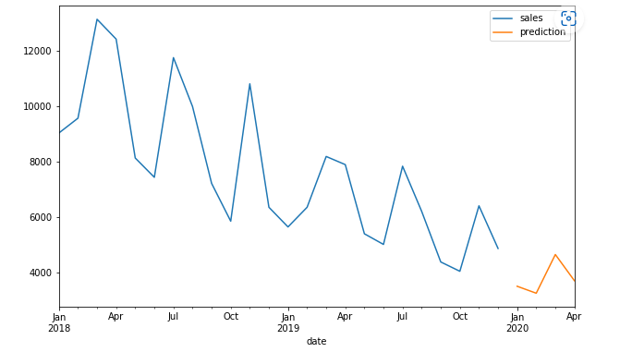
HOLTS WINTERS
We can see the Quarterly wise price predictions for the year 2018, 2019 and 2020.

Slide 33
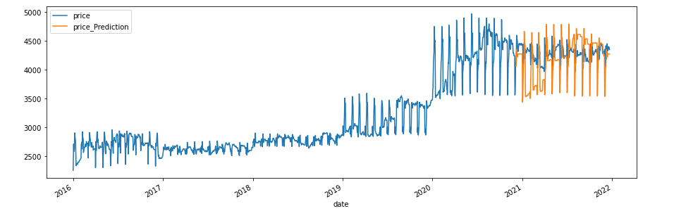
XGBOOST
In this model it is showing the yearly wise price prediction, the blue is showing the actual price and the orange line is showing the prediction price.

Slide 34
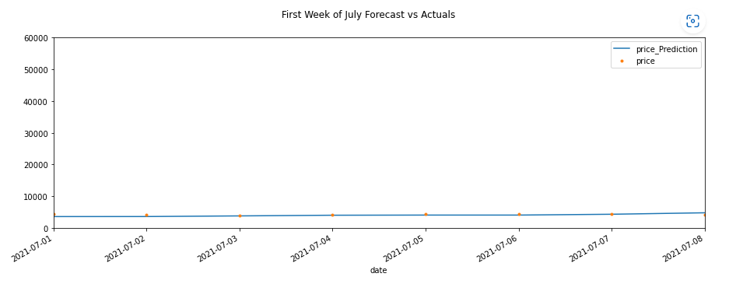
XGBOOST
We can see the actual values VS forecasting values for the first week of July.

Slide 35
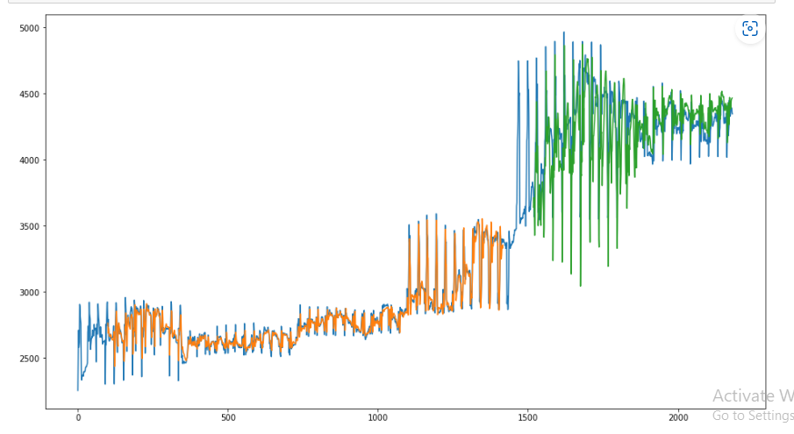
LSTM
We can see that the blue line is actual prediction and the orange line is train data prediction and green line is test data prediction.

Slide 36
Best Model
ARIMA : the model was good but having large area in C.I
SARIMA : the forecast was more linear
PROPHET : we are selecting this model
HOLT WINTERS : Predicting prices for monthly segment
XGBOOST : not sure about the trends
LSTM : Over fitting the model

Slide 37
DEPLOYMENT

Slide 38
STREAMLIT
We are using Streamlit to deploy the model
Using pickle we dump the model in a pkl file
We created the architecture of the web Application using Streamlit methods
We initialized a variable ‘date’ where the user will give the date values
We load the same model using it’s pickle file
We feed the date value to the model and print the prediction

Slide 39
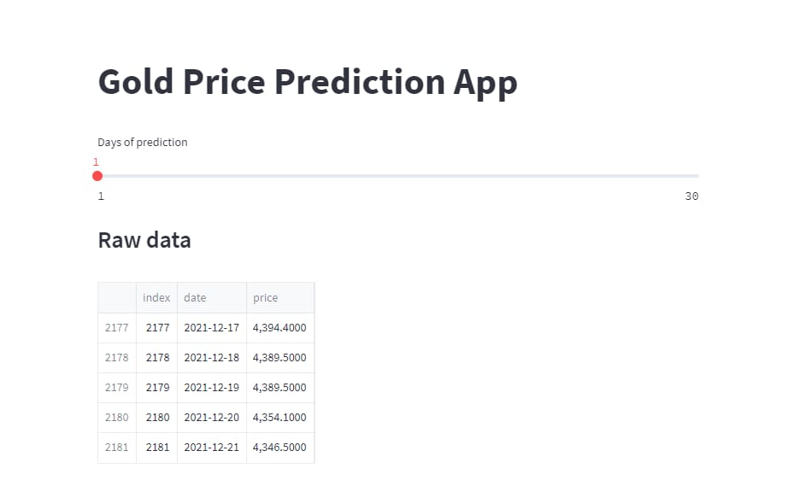
WEB INTERFACE
This is the web interface with a slider where you can drag the slider to predict furthermore days

Slide 40
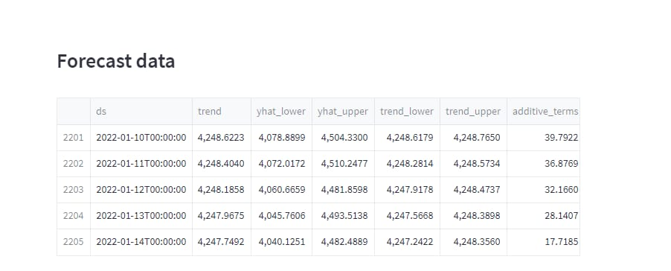
FORECASTING
These are the row wise data of the gold prices

Slide 41
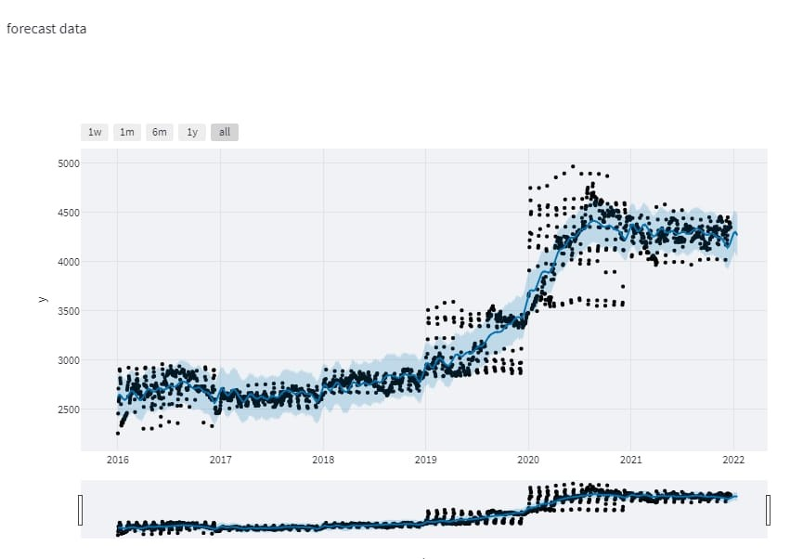
VISUAL REPRESENTATION
This is the visual representation of the forecasting of gold prices

Slide 42
Thank You
Team members :
1.Himanshu Patil
2.Indrani
3. Smita Dhuri
4. Y bheemesh kumar
5.Nidhi
6.Saurabh Mestry
7.Siri

